Slide 1
SNACK Squad : A customizable snack ordering and delivery app
Presented By
Bharath B
Kaviya G
kaveri K
Kayalvizhi S

Slide 2
Introduction Overview of Grub FSnacks: A modern food and snack delivery app that prioritizes user experience, offering seamless navigation, personalized recommendations, and reliable delivery. Core Value: Quick, user-friendly access to a wide range of food and snack options, fully customizable and optimized for both Android and iOS.

Slide 3
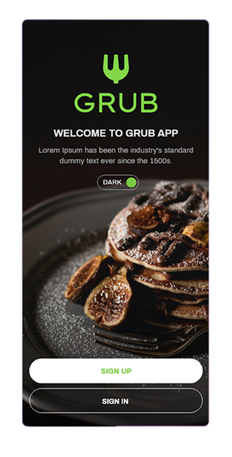
Light/Dark Mode Feature Description: Supports both light and dark modes to enhance readability and user comfort based on device settings or user preferences. User Benefit: Allows for a visually comfortable experience in different lighting environments, improving usability and aesthetic appeal.

Slide 4
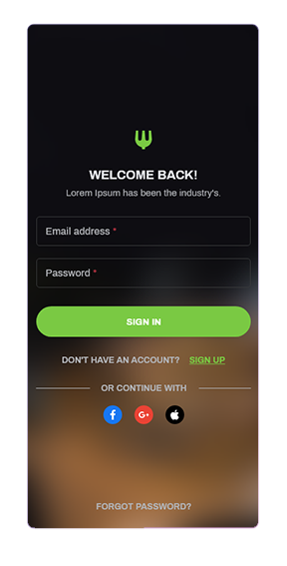
Register & Sign-In User Registration and Authentication: Secure and easy registration and sign-in options, including email, phone number, and social media integration. User Benefit: Provides a seamless, secure login experience to access personalized features and order history.

Slide 5
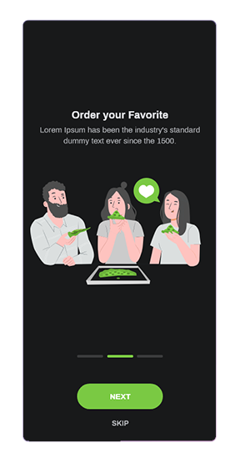
Onboarding Screens Guided Onboarding: Simple and interactive onboarding screens to introduce users to key features and navigation. User Benefit: Helps users get acquainted with the app's functionalities quickly, setting them up for a smooth experience from the start.

Slide 6
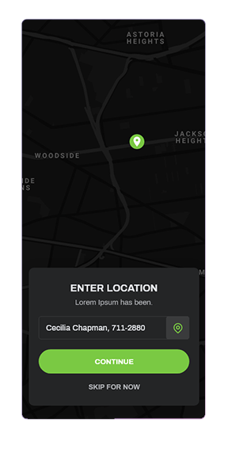
Location Services Location Tracking and Selection: Automatically detects user location or allows manual entry to find nearby restaurants. User Benefit: Ensures accurate delivery and tailored restaurant suggestions based on location.

Slide 7
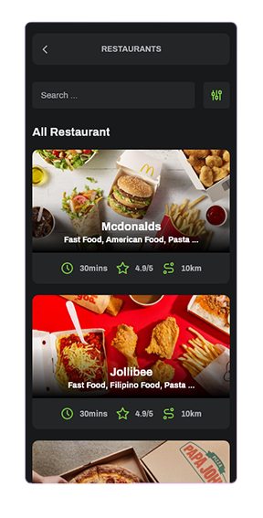
Search Functionality Search Bar: Enables users to quickly search for restaurants, food items, and snack options. User Benefit: Makes it easy to find specific items or eateries, saving time and improving the ordering experience

Slide 8
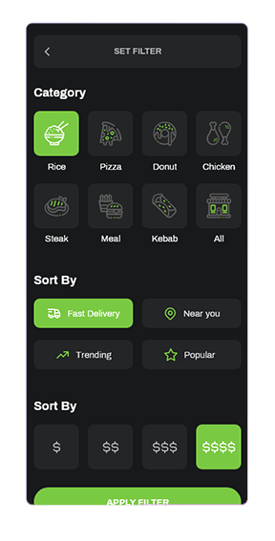
Filters and Restaurant Categories Advanced Filtering and Categorization: Allows users to filter results by cuisine, rating, price range, and more. User Benefit: Helps users narrow down options based on preferences, creating a more customized experience.

Slide 9
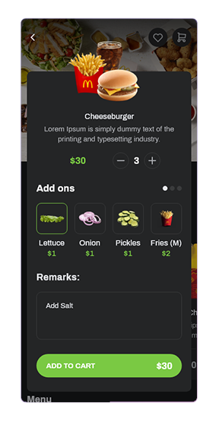
Add to Cart and Cart Management Cart Functionality: Easy-to-use cart with options to add, remove, and modify items before finalizing the order. User Benefit: Simplifies order management and helps users review and customize their selections before checkout.

Slide 10
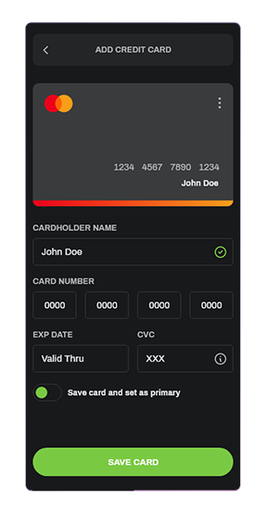
Payment Options and Credit Card Management Secure Payment Processing: Multiple payment options including credit cards, debit cards, and mobile wallets. Credit Card Management: Allows users to save, update, and delete credit card information securely. User Benefit: Makes transactions quick and secure, offering flexibility and convenience.

Slide 11
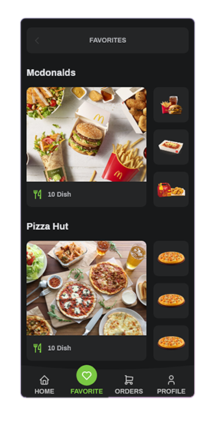
Favourites Favorite Restaurants and Dishes: Users can save their favorite restaurants and meals for easy access. User Benefit: Enhances the experience by allowing users to quickly reorder from their preferred choices.

Slide 12
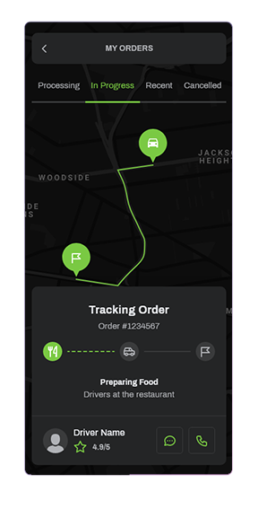
Order Tracking Real-Time Order Tracking: Provides live updates from order placement to delivery. User Benefit: Keeps users informed on their order status, offering peace of mind and transparency.

Slide 13
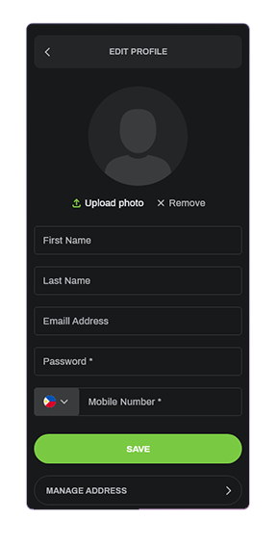
Profile Management User Profile Settings: Users can view and edit personal information, preferences, and order history. User Benefit: Centralized profile for easy management of account details, preferences, and previous orders.

Slide 14
Main Activity.xml
<?xml version="1.0" encoding="UTF-8"?>
<!--build_version=5.3-->
<!--
This the Ant build script used by the CN1BuildMojo for sending to the build server.
-->
<project name="SampleProjectTemplate" default="default" basedir="." xmlns:j2seproject1="http://www.netbeans.org/ns/j2se-project/1">
<description>Builds, tests, and runs the project SampleProjectTemplate.</description>
<property file="${codenameone_settings.properties}"/>
<property name="automated" value="false" />
<taskdef name="codeNameOne" classname="com.codename1.build.client.CodeNameOneBuildTask" classpath="${CodeNameOneBuildClient.jar}"/>

Slide 15
<target name="ios-device" depends="">
<property name="ios.debug.targetType" value="iphone"/>
<echo message="Building iOS for target ${ios.debug.targetType}"/>
<codeNameOne
jarFile="${dist.jar}"
displayName="${codename1.displayName
packageName = "${codename1.packageName}"
mainClassName = "${codename1.mainName}
version="${codename1.version}"
icon="${codename1.icon}"
vendor="${codename1.vendor}
subtitle="${codename1.secondaryTitle}"
targetType="${ios.debug.targetType}"
certificate="${codename1.ios.debug.certificate}"
certPassword="${codename1.ios.debug.certificatePassword}"
provisioningProfile="${codename1.ios.debug.provision}"
appid="${codename1.ios.appid}"
automated="${automated}"
/>
</target>

Slide 16
<target name="ios-device-release" depends="">
<property name="ios.release.targetType" value="iphone"/>
<codeNameOne
jarFile="${dist.jar}"
displayName="${codename1.displayName}"
packageName = "${codename1.packageName}"
mainClassName = "${codename1.mainName}"
version="${codename1.version}"
icon="${codename1.icon}"
vendor="${codename1.vendor}"
subtitle="${codename1.secondaryTitle}"
appStoreBuild="true"
production="true"
targetType="${ios.release.targetType}"
certificate="${codename1.ios.release.certificate}"
certPassword="${codename1.ios.release.certificatePassword}"
provisioningProfile="${codename1.ios.release.provision}"
appid="${codename1.ios.appid}"
automated="${automated}"
/>
</target>

Slide 17
<target name="check-webapp-runner">
<echo>Checking Webapp Runner...</echo>
<available file="${user.home}/.codenameone/webapp-runner.jar" property="webapprunner.present" value="true"/>
<echo message="Webapp Runner present? : ${webapprunner.present}"/>
</target>
<target name="init-webapp-runner" depends="check-webapp-runner" unless="webapprunner.present">
<mkdir dir="${user.home}/.codenameone"/>
<get src="https://github.com/codenameone/cn1-binaries/raw/master/javascript/webapp-runner.jar" dest="${user.home}/.codenameone/webapp-runner.jar"/>
</target>
<target name="check-war" depends="">
<echo>Checking War</echo>
<basename property="dist.base" file="${dist.jar}" suffix=".jar"/>
<property name="dist.war" value="dist/${dist.base}.war"/>
<available file="${dist.war}" property="war.present" value="true"/>
<echo message="War file present? ${war.present}"/>
</target>
<target name="init-war" depends="check-war" unless="war.present">
<antcall target="war"/>
</target>

Slide 18
<target name="mac-os-x-desktop" depends="">
<property name="desktop_macosx.targetType" value="desktop_macosx"/>
<codeNameOne
jarFile="${dist.jar}"
displayName="${codename1.displayName}"
packageName = "${codename1.packageName}"
mainClassName = "${codename1.mainName}"
version="${codename1.version}"
icon="${codename1.icon}"
vendor="${codename1.vendor}"
subtitle="${codename1.secondaryTitle}"
certificate="${codename1.desktop.mac.certificate}"
certPassword="${codename1.desktop.mac.certificatePassword}"
targetType="${desktop_macosx.targetType}"
automated="${automated}"
/>
</target>

Slide 19
<target name="windows-device" depends="">
<codeNameOne
jarFile="${dist.jar}"
displayName="${codename1.displayName}"
packageName = "${codename1.packageName}"
mainClassName = "${codename1.mainName}"
version="${codename1.version}"
icon="${codename1.icon}"
vendor="${codename1.vendor}"
subtitle="${codename1.secondaryTitle}"
certificate="${codename1.windows.certificate}"
certPassword="${codename1.windows.certificatePassword}"
targetType="windows"
automated="${automated}"
/>
</target>
</project>

Slide 20
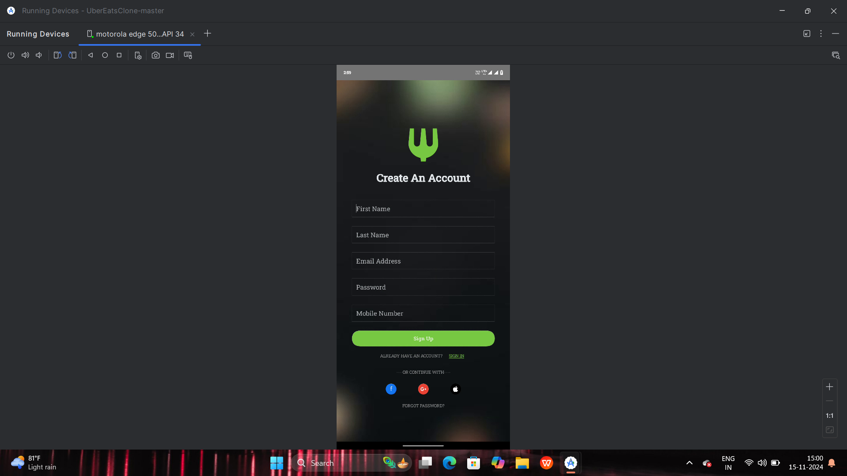
output :

Slide 21
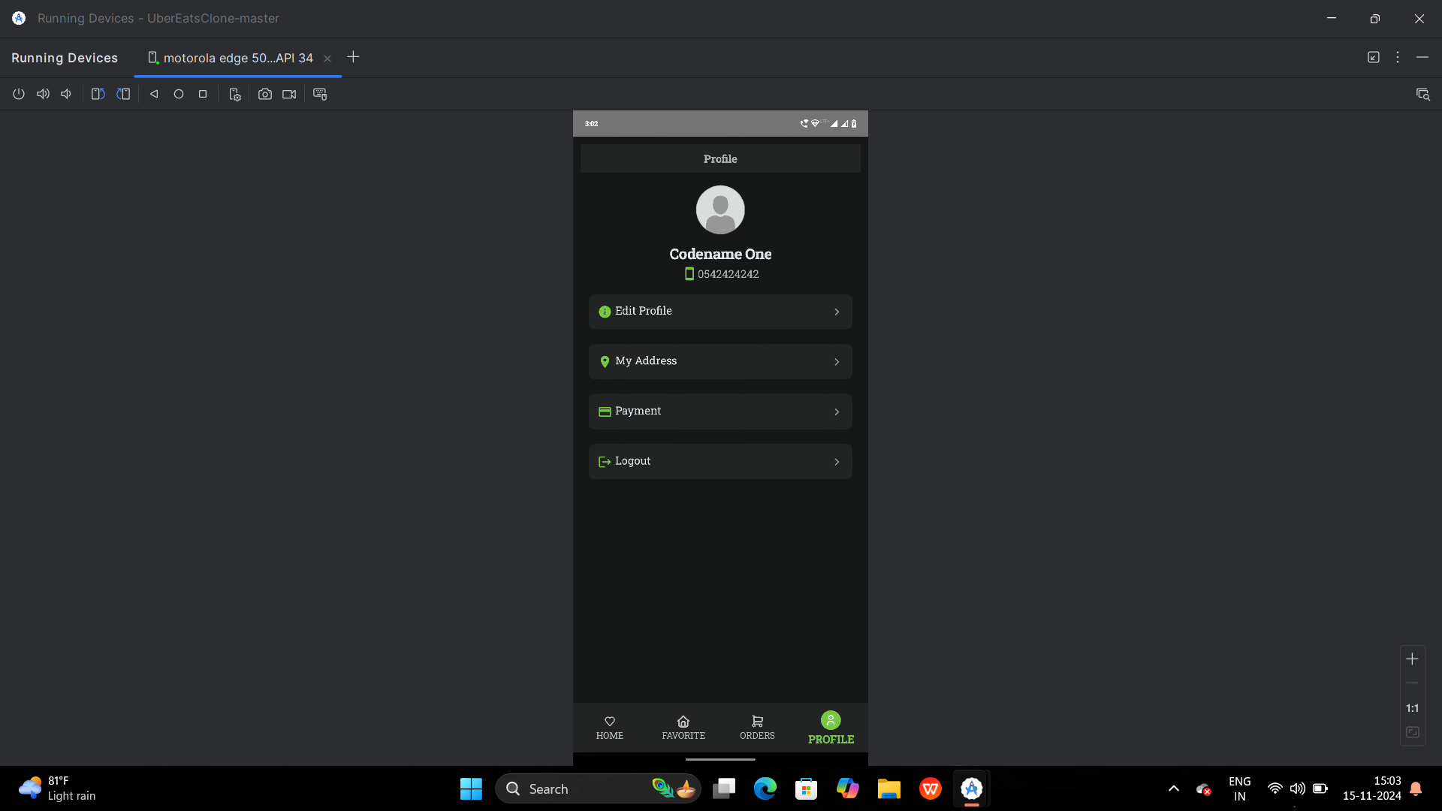

Slide 22
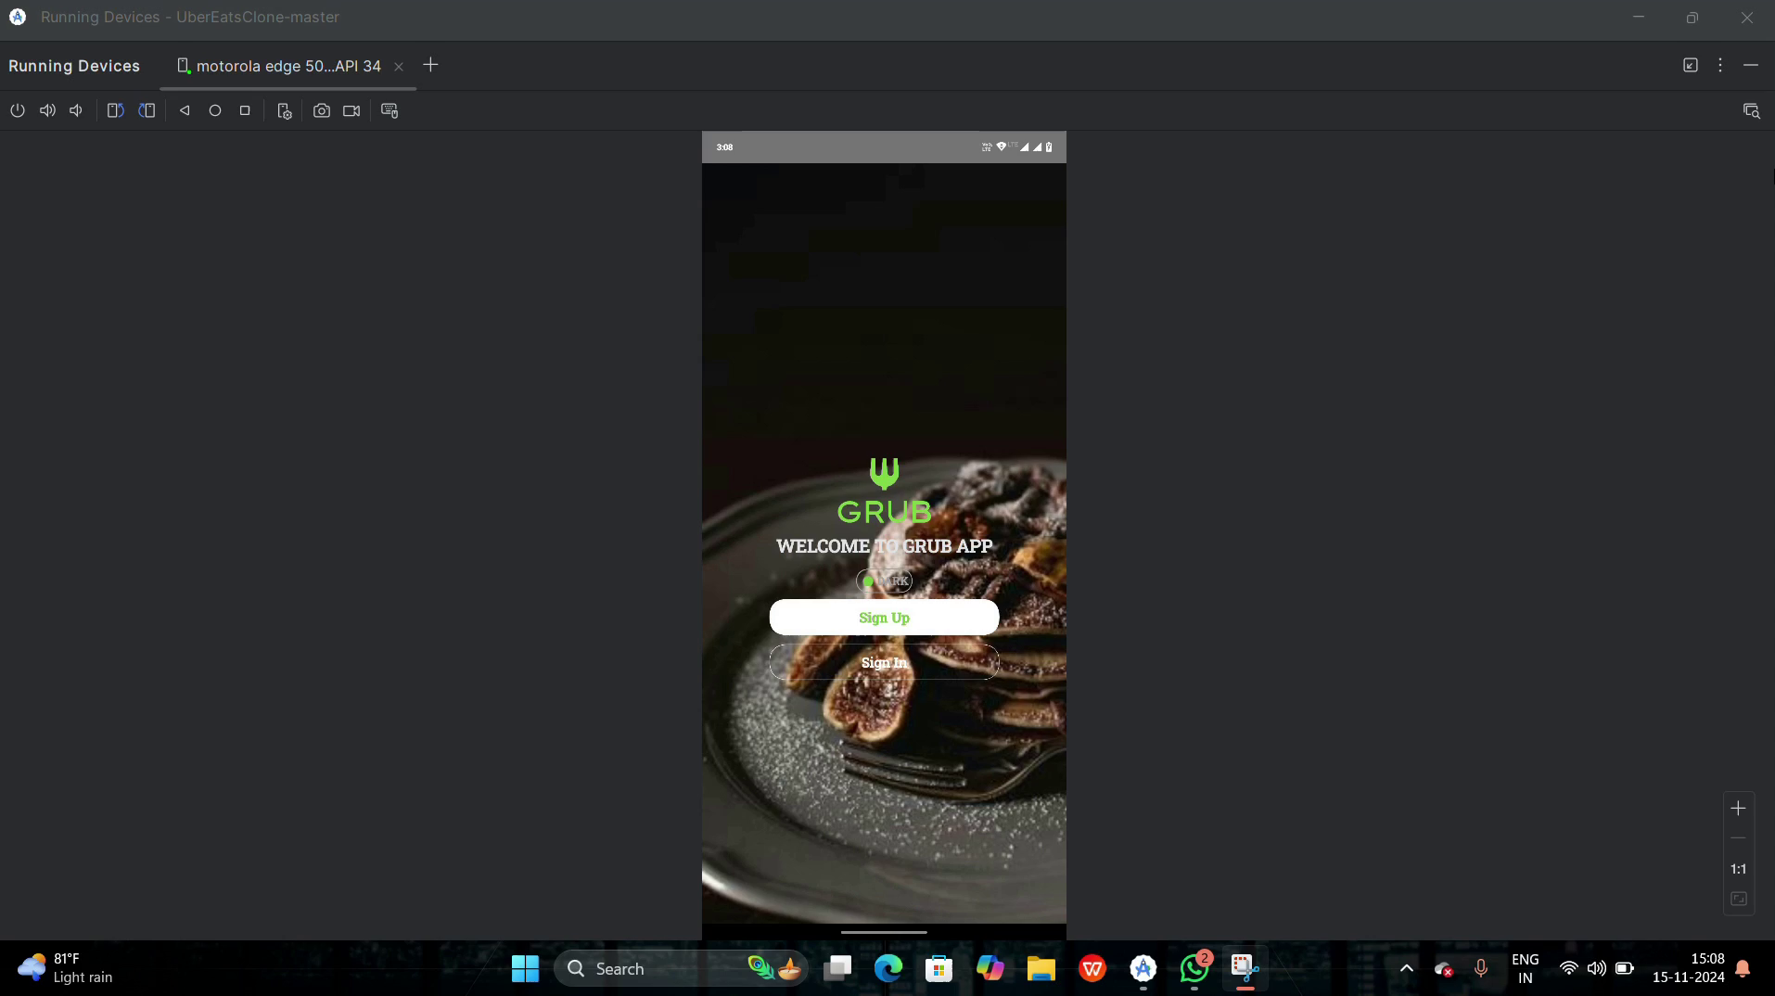
Demo video

Slide 23
Conclusion Summing Up Grub FSnacks: Highlight the key benefits, including a seamless user experience, real-time tracking, and the customization options. Call to Action: Encourage users or stakeholders to explore how Grub FSnacks can make food and snack delivery more efficient and enjoyable.

